Slide 1
Public support to consumer education and promotion campaigns

Slide 2
Political justification for supporting organic processing & marketing

Slide 3
Why spend public money to increase consumer awareness of organic?
Main bottlenecks to demand increase are: 1) product availability is stores/markets, 2) consumer awareness of benefits, and 3) product attractiveness (incl. price and quality).
Organic industry does not have sufficient resources (especially in countries with an emerging sector) to fund mass public education campaigns.
Organic Agriculture (OA) education campaign serves the goals of public health and environmental protection. Lack of information is a main reason for sub-optimal consumer choices.
Can be combined with promotion of domestic/regional products.

Slide 4
Possible ways to support organic consumer education

Slide 5
Supporting organic awareness
Open a scheme to fund / Co-fund organic information and promotion campaigns implemented by the organic industry (e.g. EU countries, Canada).
Include organic consumer awareness activities in the national organic action plan and national organic program/project implemented by the government (e.g. Saudi-Arabia, Bhutan, Tunisia, Brazil).
Type of funded actions: a permanent website, booklets and brochures, TV and radio programs, newspaper articles, billboards, social media, commercial actions in shops, etc.
Can be packaged in a yearly Organic Week or Organic Month.
Campaigns linked to the national organic logo & key slogans.
Politicians can make pro-organic public statements.

Slide 6
Country examples

Slide 7
Denmark
Danish government supports organic consumer awareness activities since 1991.
Funding goes to private sector (Organic Denmark) to implement specific projects and campaigns, promoting the national organic label.
EUR 3.3 million allocated annually. Funded activities include: harvest events and markets, messaging in traditional and social media, point-of-sale materials, information in public schools and child care centers, media relations, events and special campaigns.
In 2015 a campaign in collaboration with all major retail chains, aimed to increase retail organic sales by 10%, but achieved a 12% increase.

Slide 8
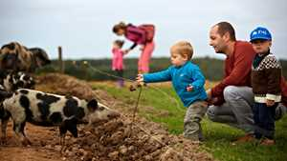
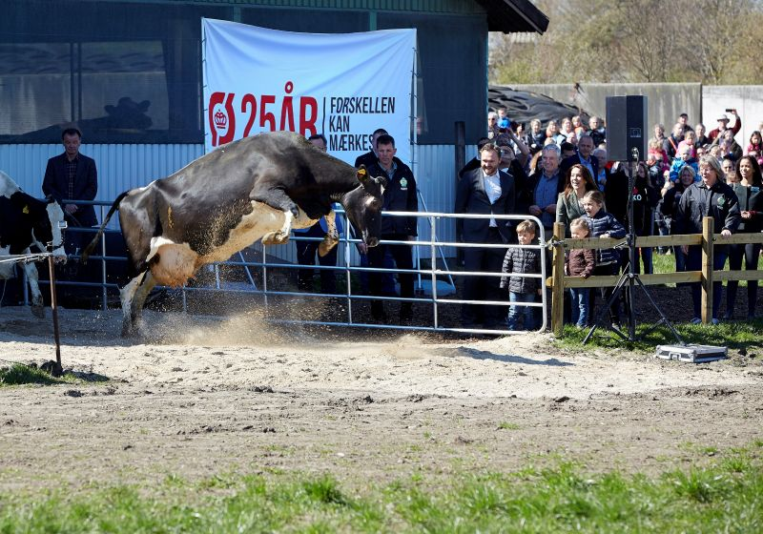
Denmark (2)
Notes:
Organic Denmark has two annual high-profile consumer awareness events:
1. The Organic Harvest markets in September and
2. Organic day, Øko-day, where consumers are invited to organic farms in springtime, to see the cows stampede out of the barns onto fresh grass after a winter inside. In 2016, more than 250,000 people visited more than 80 participating organic farms. This is almost 5% of the Danish population.

Slide 9
Saudi Arabia
The Saudi government financed and co-organized 2 national public awareness campaigns for organic products (total budget 400,000 euros).
First campaign (2011): 180 posters placed in high traffic streets and on digital billboards in shopping malls.
Second campaign (2014), over a 4-weeks period:
A press conference,
4 weeks of “organic food festivals” with big promotion of organic products in 20 supermarkets throughout the country,
Advertisement on digital billboards inside major shopping malls,
Social media campaign.
Part of a broader project that also supported the supply side.

Slide 10

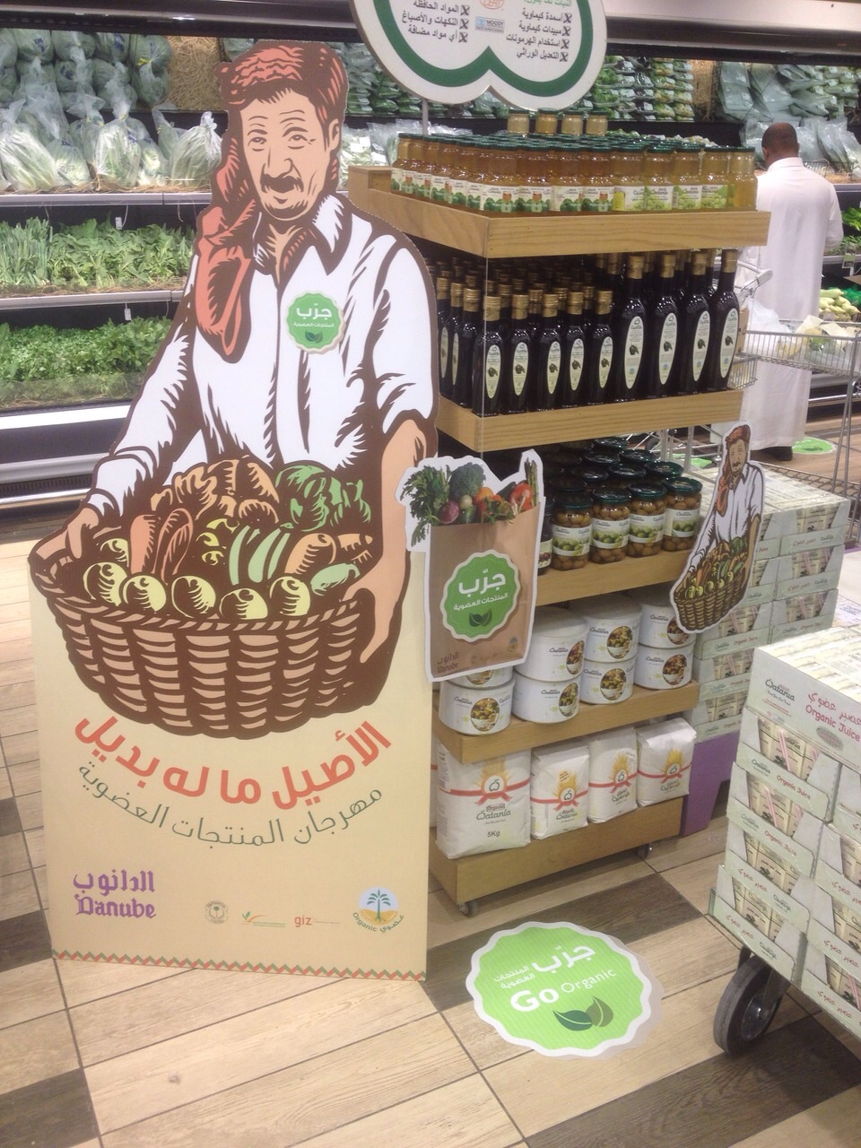
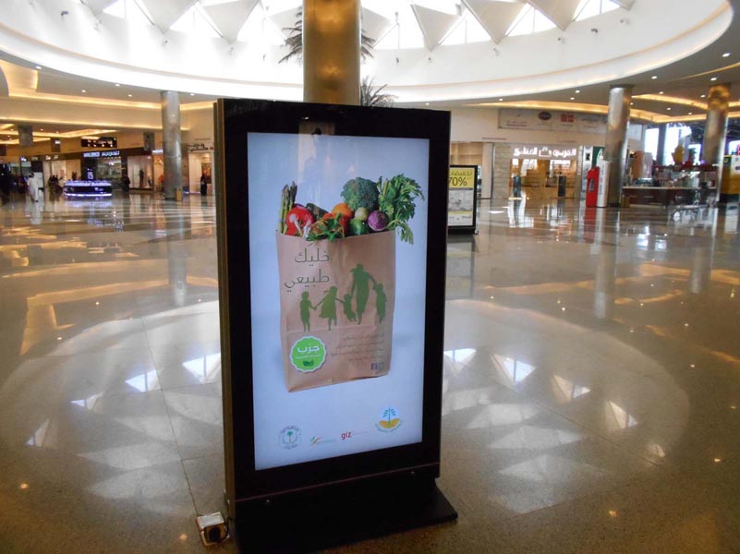
Saudi Arabia (2)
Notes:
Saudi Arabia promotion activities

Slide 11
Pitfalls and challenges of this form of support

Slide 12
Lessons learned
Risk to miss the target despite considerable spending → cooperation with the private sector maximizes chances of impact.
Mass campaigns targeting the general public in countries where supply is not available (no organic products in the shops) will be a waste of resources → do more targeted campaigns (focus on expats, LOHAS profile consumers and infant mothers).
Always direct consumers to where they can find the products.
Adapt the messages to the country’s culture (e.g. animal welfare not always a primary consumer concern).
Collect sales data annually, to monitor impact.
Notes:
LOHAS: Lifestyle of Health and Sustainability

Slide 13
Thank you for your attention!
Complete policy toolkit available at www.ifoam.bio

