Slide 1
Public procurement of organic products

Slide 2
Political justification for organic public procurement

Slide 3
Importance of public catering
In modern economies, catering sector is 30% of the total food consumption.
Catering managed by the public sector is a significant part, e.g. canteens of schools, hospitals, care homes, universities, government buildings, etc.
Offering organic food in canteens is a powerful way to raise awareness, it can an be combined with educational activities.
Allows access to organic food for all, including poor children.
Organic public procurement is a investment in environmental and socio-economic benefits.

Slide 4
Possible ways to implement organic public procurement

Slide 5
Organic public procurement
Decision to source organic products can take place at various levels from individual canteens to municipality, region or state level.
First target are usually kindergartens and school meals (children more vulnerable to pesticide residues).
If public canteen catering is outsourced to a private company, call for tender needs to include requirements on percentage of organic ingredients/menus expected.
National/regional/municipal policy can be constraining in nature (mandate minimum amount of organic food in all canteens) or incentivizing in nature (financial support/rewards for canteens who achieve certain percentages, or recognition reward).
Often combined with sourcing local products (local & organic).
Notes:
Example of recognition rewards for canteens (although not governmental): the Food for Life Catering Mark in the UK, implemented since 2009. It is found to be a successful model to incentivize caterers to source at least some organic ingredients and increase the share progressively. The mark is awarded, in different versions (Bronze, Silver and Gold) to caterers that meet certain requirements with regards to the sourcing of organic, ethical, local and environmentally friendly ingredients and meet nutritional guidelines for healthier menus.
For example, in 2013, the Soil Association reported that the number of Catering Mark meals served in UK hospitals has increased by 10 million in 12 months, and that Silver and gold caterers within the Catering Mark had spent EUR 2.2 million more on organic compared to the year before.

Slide 6
Country examples

Slide 7
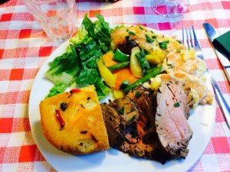
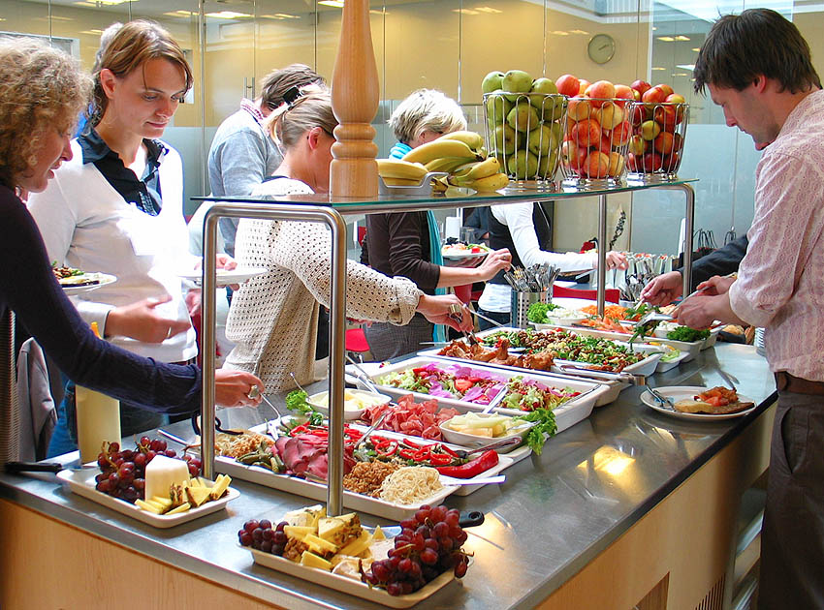
Denmark
Copenhagen managed to serve in its public canteens (20,000 meals/day) 75% of organic food in 2012 and 90% in 2015, without increasing the meal prices.
This is in an overall national effort, as the government set a goal of 60% organic in all public kitchens by 2020. Almost EUR 8 million allocated to help this transition under the organic action plan for the period 2015-2018.

Slide 8
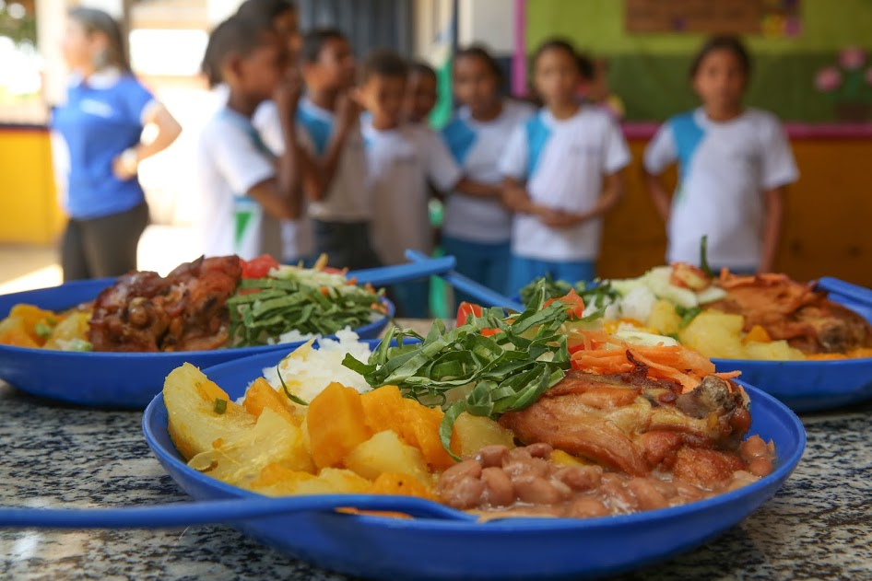
Brazil
In 2009, the National School Feeding Program (PNAE) sets an objective to purchase at least 30% of the products for school meals from local family farmers, prioritizing organic foods, purchasing at up to a 30% price premium.
The program feeds 47 million students each day in Brazilian public schools.
The city of São Paulo (12 million inhabitants) passed a decree in 2016 setting a target that by 2026, 100% of the 2 million school meals offered in the city every day should be organic.

Slide 9
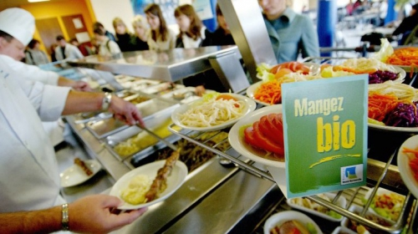
Other examples
Paris: objective of 50% organic food by 2020 in public canteens (30 million meals a year).
Region of Emilia-Romagna in Italy: 70% organic food in its public canteens.
Several smaller municipalities in France and Italy have achieved 100% organic food in their canteens.
Ministry of Agriculture in the Netherlands: 100% organic in its catering in 2007.
New Taipei (Taiwan): organic school lunch policy requiring that students must have at least 1 organic lunch each week, with planned increases as supply increases.
Notes:
New Taipei is 4 million inhabitants.

Slide 10
Pitfalls and challenges of this form of support

Slide 11
Lessons learned
Capacity building for canteen staff & catering companies is vital.
Need to organize the supply (local producers) to meet the demand of catering sector (≠ from retail demand). Can be combined with promoting OA around catchment areas, etc.
Give time for suppliers to adapt and increase volume: adopt an incremental approach ( % of organic products every year).
Price increase can be mitigated by menu adjustments. With adequate information and efforts, cost increase can be kept at around 15%.
Tendering laws can be circumvented.
Notes:
Examples of ways to mitigate price increase: Certain fruits and vegetables do not need to be peeled; cereals and meat are more nutritive than their conventional counterparts and therefore portions can be reduced; rebalancing of meals with more vegetal proteins and less animal proteins can also reduce the cost. Also less cooking, save energy, etc.
Tendering laws circumvented: Fair competition laws that apply to public procurement may seem like an obstacle to purchasing organic foods (which are not price competitive), but these can be circumvented through a range of creative procurement approaches, such as the use of quality criteria published in the call for tender, or through the establishment of parallel support processes for local organic catering companies.

Slide 12
Thank you for your attention!
Complete policy toolkit available at www.ifoam.bio

