Slide 1
Public support to domestic organic trade and retail uptake

Slide 2
Political justification for supporting domestic organic market channels

Slide 3
Creating availability of organic products
Offer creates demand, at the level of retails or street markets: more organic products on the shelves → more purchases.
In early stages of development of Organic Agriculture (OA) sector, create points of access to OA products (organic shops, organic markets, etc.).
Later on, main growth engine is through reaching consumers in the mainstream market channels (e.g. Switzerland).
One mainstream retailer decision can change a whole market (e.g. Denmark).
Encouraging uptake of OA products in existing market channels can be a VERY effective way to boost organic demand with long-lasting impact.
Notes:
Denmark story in next slide.

Slide 4
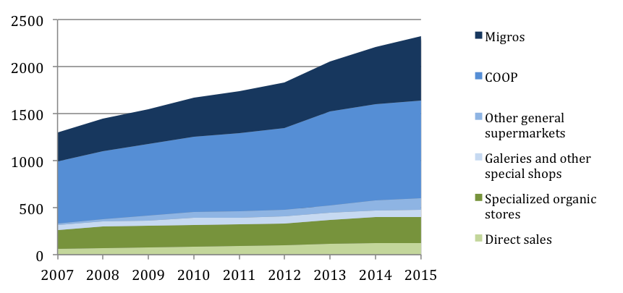
Growth of various OA market channels in Switzerland
Value of organic products sales in various market channels in Switzerland between 2007 and 2015 (in Million Swiss Francs). Source: Bio Suisse
Notes:
Nearly all that growth (86%) has happened in conventional retail market channels (in blue on the graph) whereas the specialized organic shops and direct sales (green) have remained nearly stagnant over the past 8 years.

Slide 5
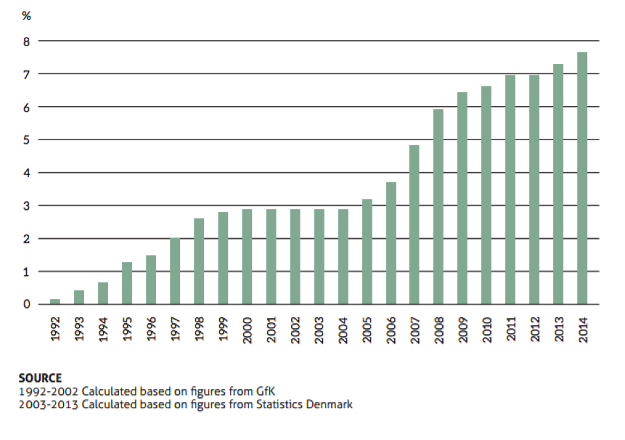
The story of OA market growth in Denmark
Denmark has the highest market share of organic products in the world (7,6%) but has no specialized organic retail sector. 97% of OA products are sold in mainstream market channels (supermarkets).
SuperBrugsen supermarket decides to promote OA products
Netto & other supermarkets decide to widen their selection of OA products
Notes:
The history of organic market growth in Denmark is basically the history of organic products uptake and marketing efforts in conventional supermarkets.
Every time a big supermarket chain takes a major action in favor of organic products, other chains (competitors) followed. Then it somewhat plateaued until a next major effort happened.

Slide 6
Possible ways to support the uptake of organic products in domestic market channels

Slide 7
Supporting various market channels
Municipalities can support weekly organic farmers markets (provide free space, subsidize market infrastructure and running costs, or pay the staff that coordinates the market, help them overcome regulatory hurdles).
National government can set-up a national program to support organic farmers markets or their associations (grant program).
Support the creation of small organic shops (free space, grant, or even government-run shops, e.g. Philippines).
Setting up projects and negotiation forums wherein supermarket owners can be encouraged/supported/incentivized to increase their organic product range.
Other ideas: support OA online marketing (e.g. Taiwan)
Notes:
Small organic shops: in emerging markets only. Sooner or later however, organic retail will (and should) develop as a profit-oriented business and it will no longer be necessary for government and public institutions to get involved in running or supporting organic shops.
Incentive can be a win-win arrangement whereby the government sponsors organic publicity campaigns that feature the name of the supermarket and directs potential organic consumers to that supermarket to find the products

Slide 8
Country examples

Slide 9
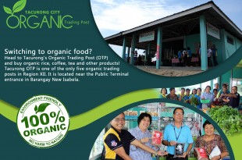
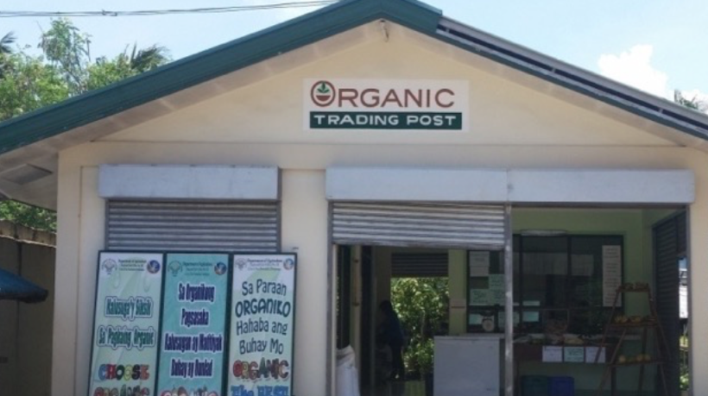
The Philippines
Government supported the set-up of 72 “Organic Trading Posts” (OTP). They serve as organic input and organic retail shops.
Local governments operate the OTP but producers also participate in the management of the OTP.
National government gave 30,000 Euros/OTP for the building, equipment and working capital and local governments provided land and expenses for operations and maintenance.
Organic Producers Trade Association (OPTA) provided training to the OTP Management Teams on Good Organic Retailing Practices, Organic Enterprise Management, Guarantee System, Finance & Marketing.
Notes:
Government asked the OPTA to provide the training

Slide 10
Saudi Arabia (1)
Organic retail uptake supported through the GIZ-MEWA project “Organic Farming Project” that run since 2011.
“Organic food festivals” were organized in partnership with two of the biggest supermarket chains in the country.
In 2014, a meeting with the CEO of Danube (large Saudi supermarket chain) was organized to present potential cooperation ideas with the project → partnership implemented as win-win agreement: Danube increased range of OA products and got associated with the public OA promotion campaign → consumers directed to Danube to buy OA products.
Tamimi Markets joined as another key supermarket partner soon after. In total 20 stores participated throughout the country.
Thereafter, 2 other supermarkets have also increased OA products by themselves (spin-off effect).
Notes:
MEWA: Ministry of Environment, Water and Agriculture

Slide 11
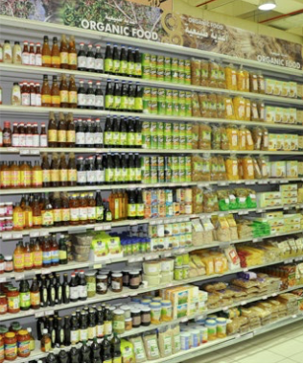
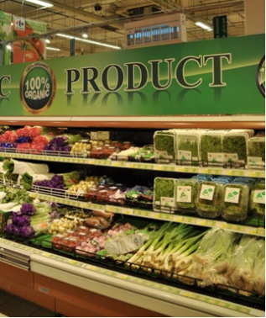
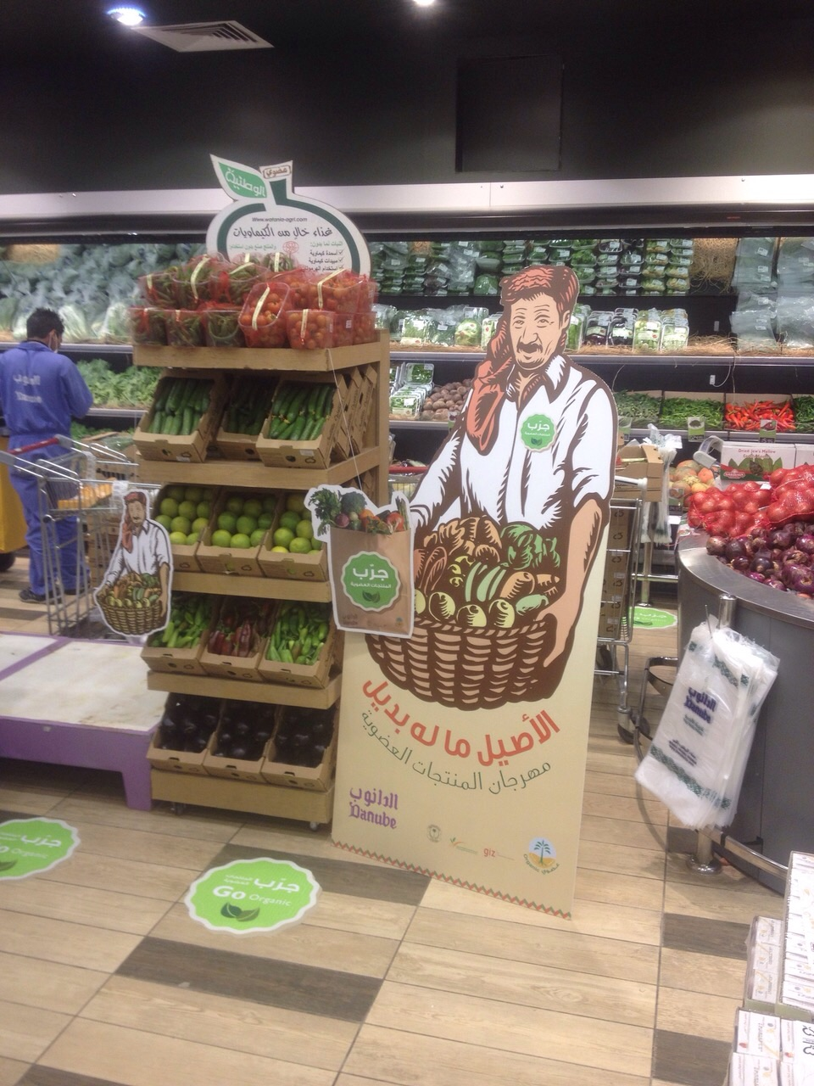
Saudi Arabia (2)
Organic section at Carrefour, Riyadh
Organic section at Danube, Riyadh

Slide 12
The Netherlands
Between 2005 and 2007, government funded the “covenant”, an agreement between the Ministry of Agriculture and practitioners of the agri-food sector who commit to stimulate the demand for organic products.
Experts were hired as food chain managers to support members of the covenant to start new activities in the organic sector segment. They looked for gaps in the production chain and encouraged the production of products in the right quantity and quality for the supermarkets to solve these gaps.
Financial support for advertising campaigns by supermarkets to promote organic
This activity received EUR 4.3 million funding for 2005-2007.
Growth rate of OA sales increased from close to 0% in 2005 to 13% in 2007.
Notes:
New Taipei is 4 million inhabitants.

Slide 13
Pitfalls and challenges of this form of support

Slide 14
Lessons learned
Ensuring reliability of supply during a major market pull effort is always challenging and needs to be planned (especially for fresh produce), otherwise it can be a complete failure.
Needs to be combined with supply-support measures or a scenario where imports of new organic products is easy & fast.
Government-run shops/markets usually have difficulties becoming viable businesses. Better for government to partner with private sector.

Slide 15
Thank you for your attention!
Complete policy toolkit available at www.ifoam.bio

