Slide 1
Public support for national organic data collection and dissemination

Slide 2
Political justification for public support to national organic data collection and dissemination

Slide 3
Importance of data availability for organic sector growth (1)
For all: needed to develop a sound national sector strategy (number and location of producers, the products, the existing marketing channels, amount of imports, etc.).
For policy makers: precise data on organic operators needed to plan the type & amount of support (subsidies), and to evaluate impact of policy measures.
For market actors: data needed to make informed decisions. Access to a directory of national producers and of existing organic businesses facilitates establishment of commercial relationship.

Slide 4
Importance of data availability for organic sector growth (2)
For consumers: a directory of organic farmers, markets and shops can help find local organic products to buy.
For international negotiations: the importance of the domestic organic sector and market needs to be substantiated by solid data.
For researchers, academic institutions and other support structures: to provide adequate outputs and services.
Tracking sector growth is important to demonstrate the sector’s potential and attract investors.

Slide 5
Possible ways to collect and disseminate national organic data

Slide 6
Organic data collection & dissemination
In early stages, governments may commission a national study/survey of the organic sector.
Cornerstone of an organic data system comprises statistics on the number of organic producers, and the area certified including crop information. In regulated countries, Certification Bodies (CB) can be required to provide this data to the CA.
To capture non-certified organic, countries with high literacy and knowledge of farmers, governments may do a census to farmers asking who considers themselves organic.
Market studies & capturing domestic organic sales values.
Specific “HS” sub-codes for organic products allow recording export and import flows.
Notes:
CA = competent authority.
HS= Harmonized Systems, an international harmonized commodity description and coding system.

Slide 7
Country examples

Slide 8
USA
Collect producer data through the certifiers. Additionally, USDA’s organic farm survey regularly collects a wide range of data on Organic Agriculture (crops, production practices, production costs, marketing practices, value addition, etc.).
For external trade data (exports and imports), the USDA introduced in 2011 selected specific HS tariff codes for selected organic products. New codes are added every year.
In the 2014 Farm Bill, EUR 3.7 million allocated annually, mostly for data collection and analysis on organic product pricing. The USDA Agricultural Marketing Service freely disseminates market and pricing information for approximately 250 organic products through its USDA Market News.
Notes:
USDA: United States Department of Agriculture`s organic farm survey every 1-2-3 years in the recent years (2008, 2011, 2014, 2015, and 2017).
HS system: Does not yet fully capture existing organic trade, but it has proven to be a useful tool to evaluate changes in trade

Slide 9
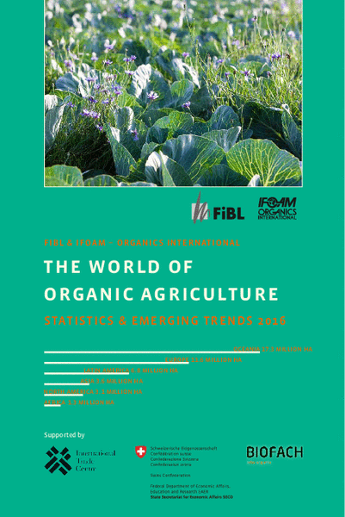
Other examples (1)
Canada also has specific HS codes for organic imports & exports. Includes Organic Agriculture (OA) questions in its official agricultural census.
Switzerland co-funds the annual compilation of global organic statistics by FiBL. “The World of Organic Agriculture”, published annually by FiBL and IFOAM-Organics International,
EU organic regulation makes data collection on OA mandatory. Data is available on Eurostat’s website: for each country the number of organic operators, the organic crop areas and production, organic livestock and livestock production.

Slide 10
Other examples (2)
In Denmark and Sweden, organic retail sales data is collected by the national statistical offices.
Statistics Sweden collects data not only for areas of organic crops but also for yields.
In France, Agence Bio maintains a directory of organic operators, a database of all organic events and a smartphone App allowing users to locate a nearby organic point of sale, restaurant or event.
Argentina: SENASA collects yearly data for area, livestock and export volume data, including exports by destination.
The Philippines: The National Organic Agriculture Program publishes yearly statistics that include third party certified, PGS-certified and non-certified organic producers. Data is obtained through agricultural technicians in the Local Government Units.
Notes:
SENASA: National Food Safety and Quality Service

Slide 11
Pitfalls and challenges of this form of support

Slide 12
Lessons learned
Number of indicators monitored must grow as the sector grows: e.g. area and operator data are the basic, then volumes and value of production, retail sales, and imports and exports.
Need to increase the accuracy of the data collected. Some data collected by governments are not plausible. Need a system of routine quality checks (improving sampling methods, applying plausibility checks, and crosschecking with other sources).
Efforts needed to harmonize statistical processes at the international level, to improve comparability and coherence.
Data most valuable when it is collected over time in a reliable, consistent, and frequent manner → governments should ensure permanent funding for this activity.

Slide 13
Thank you for your attention!
Complete policy toolkit available at www.ifoam.bio

