Slide 1
Conversion and maintenance area payments for organic production

Slide 2
Political justification for organic area payments

Slide 3
Compensate organic farmers for positive externalities
Main logic is to compensate organic farmers for the positive externalities that they produce, or the negative externalities that they do not produce, through Organic Agriculture (OA).
Support conversion to OA with extra income in the absence of a premium price.
Strong “push” measure that can bring enough farmers to convert to enable economies of scale to allow building the rest of the organic supply chain.
Modulate the incentives for various crops (e.g. leguminous crops if organic protein feed is lacking nationally).
Area payments to OA are acceptable forms of agricultural subsidies under the WTO agreement (green box).
Notes:
”Push” measure in early stages of market development, when demand is not enough: It can therefore create a temporary situation of supply-demand imbalance, which, if addressed by other measures to support organic processing and marketing, leads to a next-level supply-demand equilibrium for the organic sector.

Slide 4
Possible ways to implement organic area payments

Slide 5
Organic area payments
Multi-year payments to organic farmers. Subsidies/ha depends on the type of crop. Usually linked to certification as a criterion.
Often differentiated payments for conversion (higher) and maintenance (lower).
Calculation is until now mostly based on compensating the additional costs and income foregone from farming organically (not on the value of externalities produced by OA).
Organic livestock is indirectly supported through area payments for organic pastures. Per-unit payments for organic livestock are an alternative.
Some complex calculation systems (e.g. Switzerland with SLU).
Some cases of a one-time payment for conversion with commitment to farm organically thereafter.
Notes:
SLU: The Standard Labour Unit records the overall working time requirement of a farm using standardized factors. The agricultural area is one factor that comes into the calculation of this index, but in combination with many other factors. This calculation index is meant to be a fairer way to support small labor-intensive farms than the area calculation alone, especially when lower limits are applied as a criterion for accessing subsidies. This index is called “unités de main d’œuvre standard (UMOS)”. More details on this index is available at https://www.blw.admin.ch/blw/fr/home/instrumente/grundlagen-und-querschnittsthemen/sak.html

Slide 6
Country examples

Slide 7
Belgium
Support to OA through area payments started in 1994 after the introduction of the 2078/92 EU organic regulation.
Since 2003, consistently high level of payments for OA in Flanders and Wallonia → steady growth, tripling the organic area between 2005 and 2014.
Annual conversion payments are around:
  300 €/ha for grassland
  450 €/ha for arable land
  900 €/ha for horticulture and arboriculture
Notes:
Wallonia has a degressive payment model whereby the payment level per ha decreases when the farm organic area increases. Nevertheless, payments have remained in the same order of magnitude between 2004 and 2014.

Slide 8
Bulgaria
Notes:
Bulgaria is an example of country where organic sector development was triggered mainly through financial support (subsidies), while other factors (market demand, organic associations and social movement) were nearly non-existent. This happened after Bulgaria’s accession to the EU, when the structural communitarian funds started providing financial incentives for the development of the organic sector. From 2011 to 2012, following the introduction of area payments, organic farming in Bulgaria expanded from 1054 to 2016 operators in only one year.

Slide 9
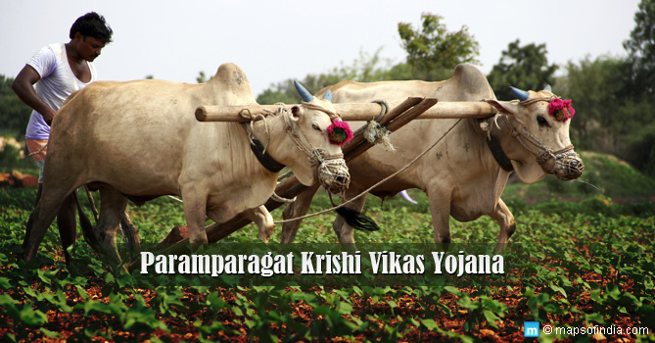
India
Paramparagat Krishi Vikas Yojana (PKVY) scheme includes a subsidy of 680 €/ha for 3 years for farmers organized in clusters.
A 3-year national budget for PKVY of about EUR 55 million is allocated to Indian States based on a calculation including area under organic cultivation and other factors.

Slide 10
Pitfalls and challenges of this form of support

Slide 11
Main challenges
Biggest challenge is lack of government budget or willingness to subsidize agriculture in general.
Difficulty for small farmers to apply for the scheme and for governments to administer the paperwork.
Predicting the uptake of the scheme (and therefore foresee budget allocation) is a challenge.
Ensure continuity of the scheme over longer period than political mandates. Every change of scheme is difficult for farmers.
May have proportionally more impact on extensive systems and less on intensive regions or farms → accentuate the concentration of OA on marginal lands while more productive lands remain conventional.
Must be accompanied by “pull” measures otherwise price 
Notes:
Challenge to predict the uptake of the scheme: A dramatic illustration of this problem is the case of Romania, where the government estimated that about 300 very small farmers (less than 5 ha) would convert to organic farming based on the area payment conversion subsidy scheme that was adopted in 2010 and that foresaw a subsidy of EUR 1,500 (maximum) per farm for those small farmers. However, more than 7,000 farmers in this category applied for the subsidy scheme, of whom 6,550 were eligible. Because the government had budgeted a fixed total budget for this subsidy scheme, the strong uptake of organic farming led the payment per farm to drop from a maximum of EUR 1,500 to a maximum of EUR 80 per farm. This was a huge disappointment for farmers who had signed a commitment to practice organic farming for at least 5 years.

Slide 12
Thank you for your attention!
Complete policy toolkit available at www.ifoam.bio

