Slide 1
Public support to organic input development and use

Slide 2
Political justification for supporting organic input development and use

Slide 3
Reducing chemical use in agriculture: a benefit for all
Use of chemical inputs in agriculture (toxic pesticides and over-application of chemical fertilizers) is one of the main factors of environmental and health damage.
Reducing chemical use is a key objective to achieve sustainability in agriculture → requires the development of alternative inputs like those used in Organic Agriculture (OA).
Public support/funding for R&D needed for alternative inputs to compensate for decades of public research and support into agro-chemical research and companies.
Plant breeding efforts in the past decades have also favored varieties for conventional agriculture. High need for organically-suitable varieties or even organically-bred varieties to enable organic producers to meet OA standards.
Notes:
Will benefit all farmers, not just organic ones, as conventional farmers are also more and more expected to reduce the use of toxic chemicals, reduce impact on water quality, protect biodiversity, etc.

Slide 4
Possible ways to support organic input development & use

Slide 5
Public support to organic inputs
Special research funds for organic input development.
Grants to support companies in doing R&D on organic inputs.
Some governments develop and manufacture organic inputs and distribute them to farmers free of charge or at very low costs.
Exempting organic inputs from certain taxes and import duties.
Subsidies to farmers for the purchase or the self-production of organic inputs (ongoing subsidies or investment grants).
Making special provisions for the official registration of organic inputs (easier, faster & cheaper).
Notes:
Government development, manufacture and distribution of organic inputs: e.g. Philippines, Sikkim (India), Bhutan.
Taxes and import duty exemption: e.g. Tunisia.
Subsidies to farmers: e.g. Mexico, India, South Korea

Slide 6
Country examples

Slide 7
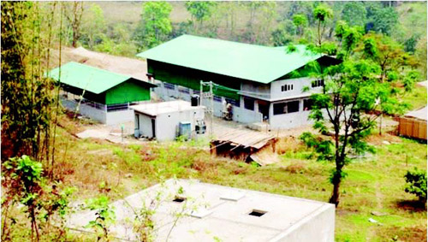
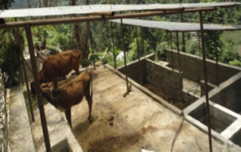
Sikkim (India)
Sikkim Organic Mission launched in 2010 with the objective to convert the entire state to OA by 2015 (achieved in Dec. 2015).
Sikkim government produced many organic inputs with state budget and distributed them to farmers: structures for vermi-composting, worms, bio fertilizers, EM, mineral amendments, bio-control agents, etc.
Government contracted seed producers, purchased organic seeds and organized distribution. Government-run automated greenhouses for quality organic seedling production were also established.
Notes:
Allocating resources to facilitate farmers’ access to organic seeds and planting materials is an overlooked aspect of the action plans of most other developing countries. “Seed is the most important input of any agricultural production and it should be free from chemicals,” states the 2014 progress report on the Sikkim Organic Mission.

Slide 8
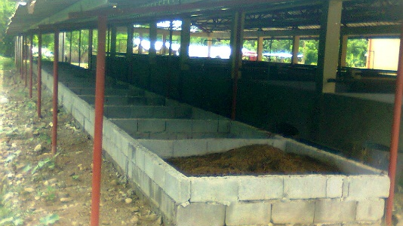
The Philippines
Vermicompost facility built by one of the Local Government Units in The Philippines
Between 2011 and 2015, the government:
Established, maintained and upgraded 746 organic input product facilities.
Distributed more than:
199,000 kg of organic seeds,
233,000 planting materials,
1.1 MT of organic fertilizers and other inputs,
4.4 million pcs of Bio Control Agents.
Worms were given to thousands of households to start on-farm vermicomposting.
The government also distributed thousands of organic animals, including organic fish fingerlings and brood stock.

Slide 9
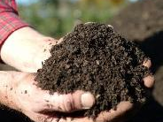
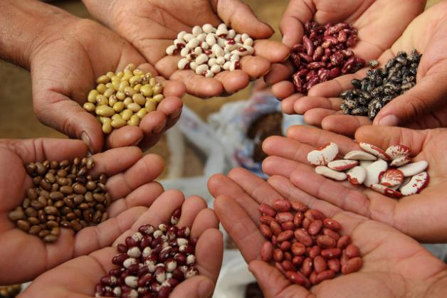
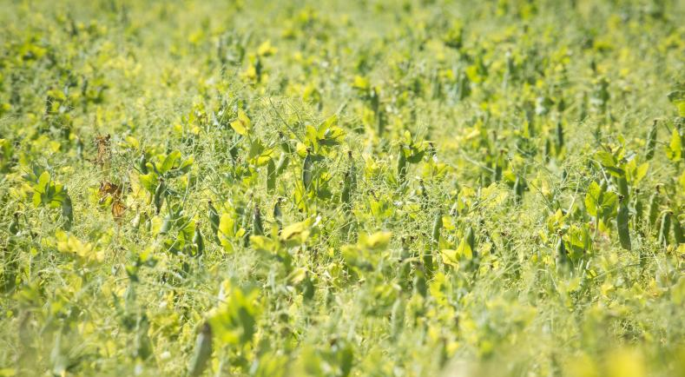
Other examples
Mexico: The Federal Government subsidizes producers with 50% of the total cost of permitted organic inputs. Other countries that subsidize farmers to purchase organic fertilizers include South Korea, Taiwan, Nepal, Sri Lanka and Indonesia.
Brazil: The Federal Government spent EUR 2,7 million in 2013-214 under the food public procurement program to purchase seeds of local and traditional varieties and distribute to farmers.
Government-funded programs in Germany, France and Sweden to develop local protein feed supply for organic livestock to replace organic soya imports.

Slide 10
Pitfalls and challenges of this form of support

Slide 11
Main challenges
Pro-organic input efforts can be counteracted by general agricultural policies subsidizing/supporting conventional inputs.
Too much in the hands of government, not enough private sector involvement is a risk.
Risk to feed the misconception that OA is about input replacement with low attention to holistic farm management.
Some commercial organic inputs are rather ineffective and sold at very high price (subsidizing those would be waste of public money).
Notes:
The risk of putting too much implementation in the hands of the government, and not enough into the hands of the private organic sector: This can be particularly problematic when public servants are asked to deliver training or to plan organic input production and delivery, without having the right knowledge and understanding of organic agriculture. E.g.: the experience of Thailand shows that training on organic inputs delivered by government agencies that have no knowledge or belief in organic farming leads to inappropriate content and methodologies, emphasis on the wrong approaches, and ultimately failure to achieve the policy objective.

Slide 12
Thank you for your attention!
Complete policy toolkit available at www.ifoam.bio

