Slide 1
Public support to companies for organic processing, product development and marketing

Slide 2
Political justification for supporting organic processing & marketing

Slide 3
Supporting the organic value addition
Processing, product development and marketing means a bigger range of organic products can be available in the market → enhances consumer choices and spurs demand.
Developing national organic value addition means keeping money in the domestic economy (organic processing is more profitable than only export of raw materials).
Reduce dependency on organic imported processed products.
Support to processing, product development and marketing can help organic companies enter the mainstream market channels, which will be a major factor for organic growth.

Slide 4
Possible ways to support organic processing, product development and marketing

Slide 5
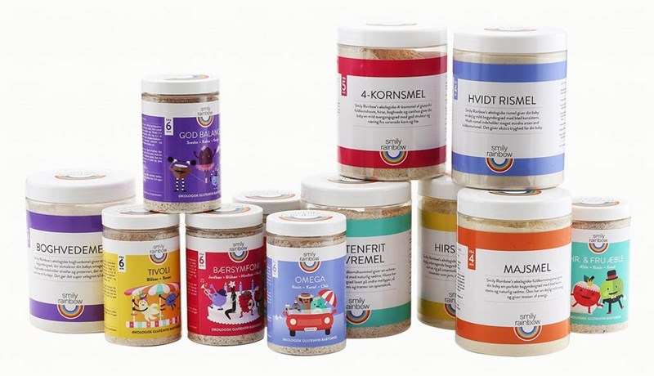
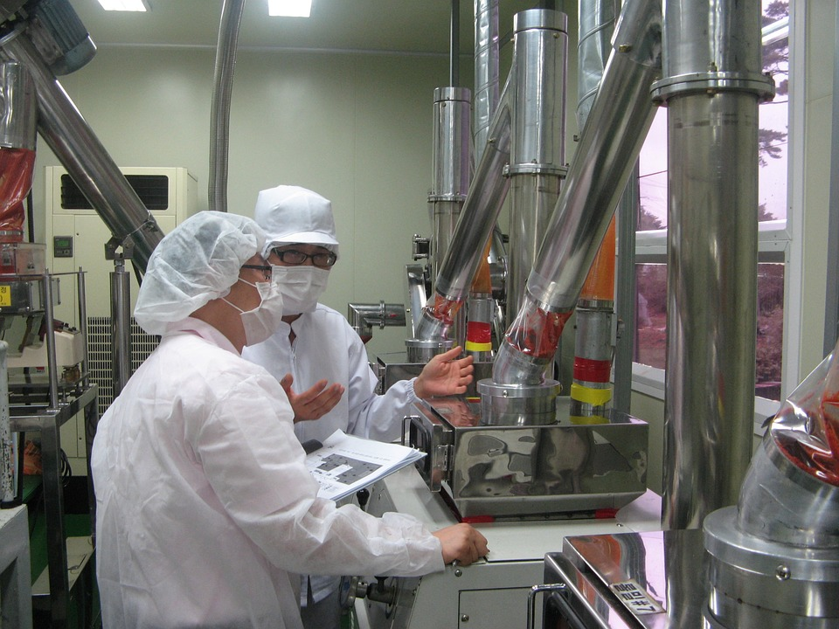
Support to organic companies
Investment support (e.g. grants) for processing facilities.
Provision of free or subsidized technical support to innovation and development in processing (best implemented in cooperation with the private sector).
Support collective marketing strategies for a certain category of product (e.g. organic regional traditional products).
Provision or financing of general organic market information (e.g. consumer surveys & market studies).

Slide 6
Country examples

Slide 7
EU
Financial support to organic processing and marketing projects provided in several countries since 1994.
Austria: between 1994 and 1999, EUR 470,000 annually allocated to support organic processing and marketing projects.
Germany invested EUR 39 million on organic processing and marketing support between 1994 and 2007.
Type of support: grants for the development of local processing facilities, development of co‐operative marketing ventures, establishment of effective market information systems or support for participating in trade fairs and exhibitions.

Slide 8
Denmark
Ministry of Food and Agriculture, and Ministry of Growth and Business allocated funding to the “Mobile product development team” program implemented by Organic Denmark.
The team consists of product development specialists, chefs, packaging designers and other experts to advise small organic companies on processing and marketing issues.
Enabled the development of 400 new organic products within 5 years.
Second phase after 2013 enabled 230 products within 3 years. Funding received was EUR 2 million, led to a growth in 50 recipient companies of EUR 62 million and 25% job increase.
The Product Development Team continues as a consultancy service

Slide 9
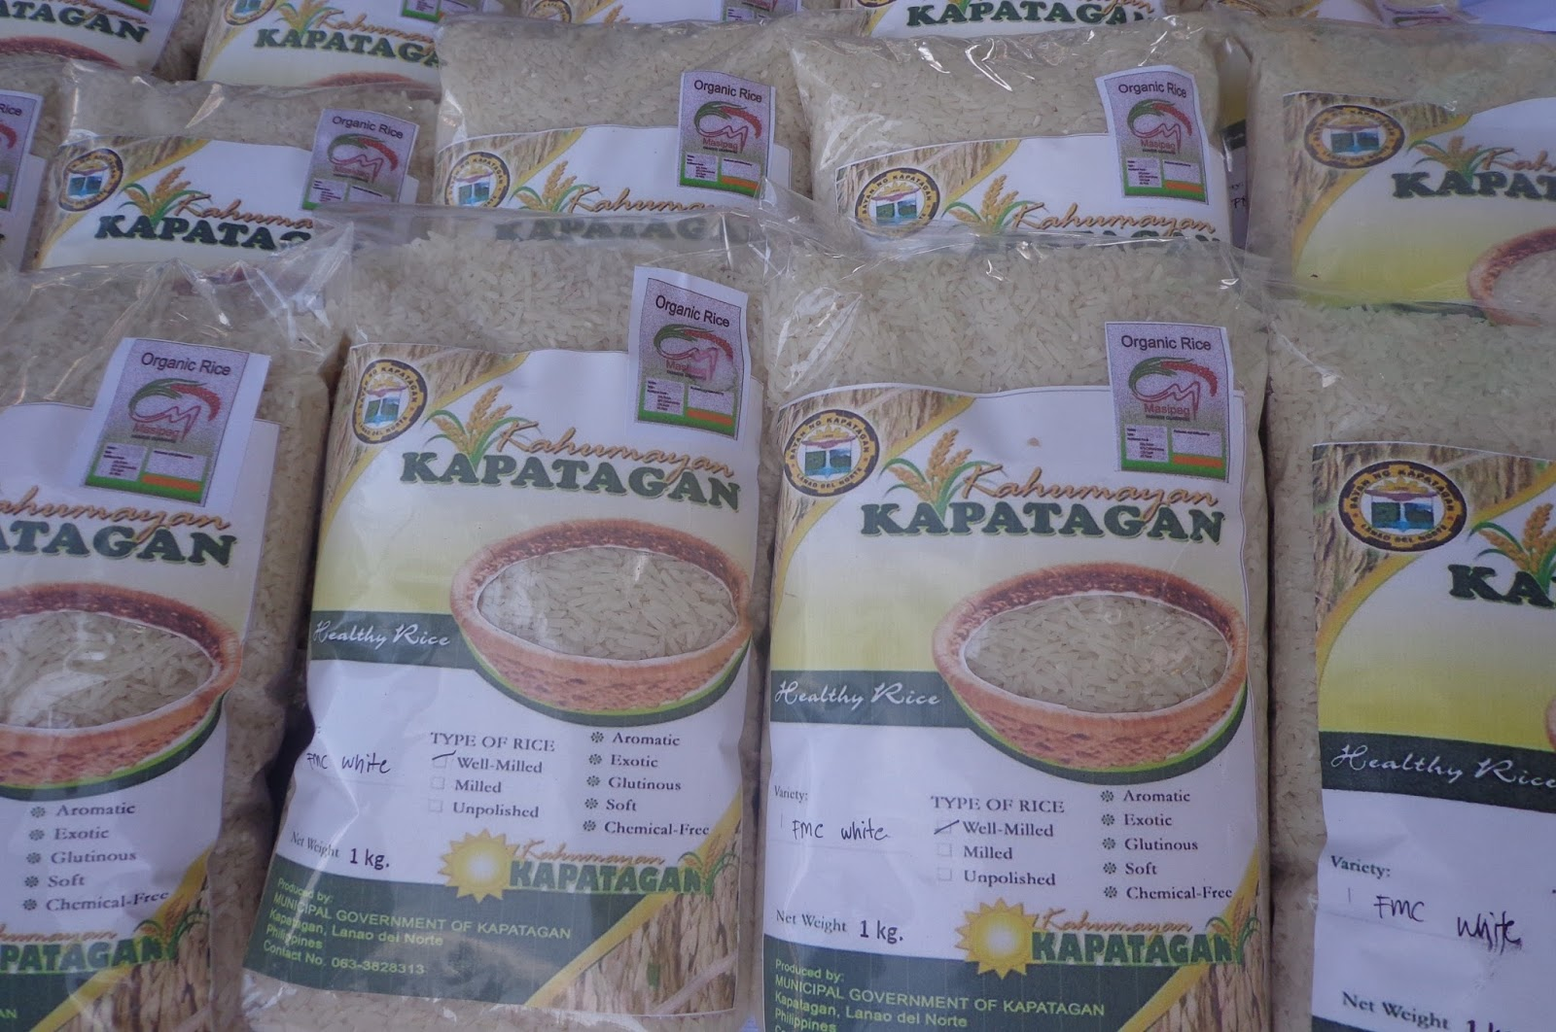
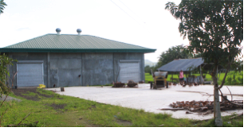
Kapatagan municipality, The Philippines
In 2008, the municipality local government decided to make Kapatagan an organic municipality.
Rice is the main crop. In 2014, local government built a processing unit for organic rice, to avoid risk of contamination with conventional rice.
Unit includes solar dryer, rice mill and warehouse. Cost was EUR 58,000, fully paid by municipality + DoA regional office.
Facility is useable by 3rd party certified or PGS certified organic farmers. Facility is managed by the farmers’ association.

Slide 10
Pitfalls and challenges of this form of support

Slide 11
Main challenges
If support to organic processing & marketing is embedded in general support policies (not just for organic), access criteria may need to be differentiated (organic companies are usually smaller).
Organic producer groups may lack the capital to meet co-funding requirements.
Profitability assessment and assisting in business planning is necessary to make sure supported businesses are viable.
Criteria to access support, such as minimum of 50% of the processing business being organic likely to favor small facilities, which are not necessarily the most competitive.

Slide 12
Thank you for your attention!
Complete policy toolkit available at www.ifoam.bio

