Slide 1
Public support to organic agriculture through tax breaks

Slide 2
Political justification for tax breaks for organic operators

Slide 3
Incentivize organic business
Recognize positive externalities generated by Organic Agriculture (OA) → lower public taxes on OA businesses to encourage uptake.
Incentivize organic business and foreign investment in OA.
Tax breaks do not distort much the production and business choices, compared to certain measures. Private investment decisions are free to follow market opportunities.
Low tax level on the OA sector increases international competitiveness and can therefore boost exports or import substitution, while being WTO-compatible.

Slide 4
Possible ways to implement tax breaks for organic operators

Slide 5
Tax break modalities
Depending on which tax the credit is applied to, and what can be subtracted from the tax (fixed amount or certain eligible costs), it may support various aspects of the organic supply chain (e.g. production, processing, export, import).
Ultimate approach: tax exemption - the state renounces tax on organic operators or on the sales of organic products.
Can be temporary (income tax holiday) for a few start-up years.
Tax credit on the farm income/profit tax can be of a fixed amount per farm or deduction of certain types of eligible farm expenses.
Exempt organic farmers from the land property tax (with obligation for landlords to pass down benefits to tenants).
Reduced import tariffs for organic products or exempting export from export taxes (if a specific HS code exist for OA products).
Notes:
HS codes : Harmonized Systems codes

Slide 6
Country examples

Slide 7
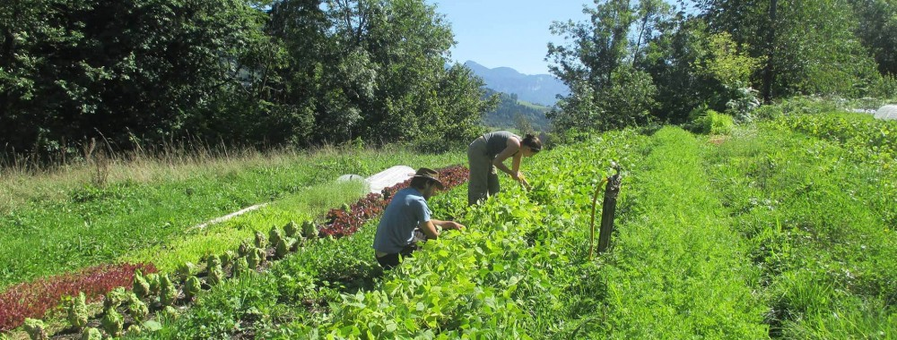
France
Main support to OA in France is through conversion and maintenance area payments. However, very small farmers receive very little subsidy support under such scheme.
In 2006, France added a tax credit measure for OA farmers. Tax credit is set at max EUR 2,500/farm, combinable with area payments if the total ≤ EUR 4,000 per farm → relevant only for farmers who receive < than EUR 4,000 area payment subsidies/year.

Slide 8

Hawaii, USA
In June 2016, a Hawaii House Bill allocated EUR 1.8 million to offset, in the form of tax credits, the 25% of the certification costs not covered by the federal organic certification cost share program + OA equipment, materials and supplies.
This bill gives organic farmers up to EUR 44,800 in tax credits for qualifying expenses.

Slide 9
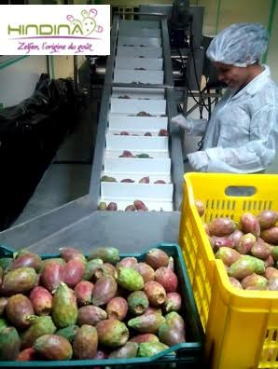
Tunisia
To attract foreign investments in OA, Tunisia implemented:
  A full income tax exemption for organic business through the first 10 years and 10% exemption thereafter.
  Full tax relief provided on income and benefits reinvested as part of the starting capital in OA companies.

Slide 10
Pitfalls and challenges of this form of support

Slide 11
Main challenges
Cases exist, where a tax exemption for organic operators has been decided by the government but never effectively implemented due to complex administrative procedures.
Even when implemented, uptake by farmers is usually a bottleneck (too much paperwork). Few are aware (lack of communication).
Corruption is another risk (high potential for abuse). Criteria for access must be simple, clear and objective, to limit the risk.

Slide 12
Thank you for your attention!
Complete policy toolkit available at www.ifoam.bio

