Slide 1
Why should policy makers support organic agriculture

Slide 2
The academic perspective: economic rational
State intervention is economically justified when:
It corrects the negative effects of earlier government interventions (e.g. green revolution push and “agriculture modernization” policies…).
A lack of information severely impedes market functions.
Market failures arise due to the nature of the goods involved such as public goods and externalities.
Markets lead to a socially unacceptable income distribution.
State intervention can also be a national investment to kick-start a sector with high potential (e.g. to establish oneself on the international organic commodity market).
Notes:
Lack of information: e.g. consumers do not know how a food is produced and the potential damages to their health due to pesticide use, etc.
Market failure: e.g. agriculture fulfills many public goods, not reflected in the price of foods.
Socially unacceptable income distribution: e.g. “free” agricultural markets lead to impoverishment of small farmers producing most of the world’s food supply.

Slide 3
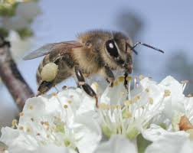
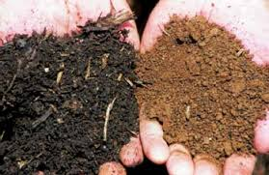

The public goods generated by OA (1)
Environmental protection – ecosystem services:
Biodiversity protection (including of agricultural use, e.g. pollinating insects, pest predators)
Preservation of water quality and less use of water.
Maintains the soil capital for future generations (combat soil erosion, desertification, loss of fertility)
Mitigating climate change through carbon sequestration in the soil

Slide 4

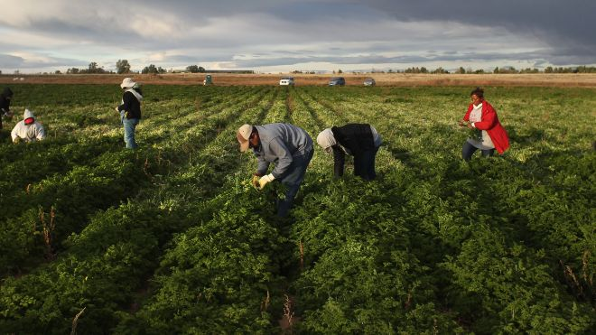
The public goods generated by OA (2)
Rural development and landscapes
Keeps people farming in less favored areas – supports a balanced territorial development and less urban immigration
Preserves beautiful and diverse rural landscapes
OA is more labor-intensive : creates jobs in rural areas

Slide 5
The public goods generated by OA (3)
Public health:
Avoids spreading toxic chemicals in the environment
Protect the health of agricultural workers
Reduces pesticide residues in food
Organic foods are richer in nutrients, anti-oxidants, etc.
Organic production systems offer more diverse nutrition in subsistence farming systems

Slide 6
Why “subsidize” organic agriculture?
Organic agriculture is “multi-functional”: it produces food and many public goods. The food production function is remunerated by the market. Public goods must be remunerated through other means, primarily public support.
Upcoming concept of “true cost accounting”
+ at early stages of development of the sector, “subsidization is justified by the “infant industry argument”: there are obstacles to transition that needs to be levied, such as farmers’ fear of social exclusion, low economies of scale, lack of organized value chains, lack of knowledge at all levels, etc.
Notes:
Subsidize here is meant in the broadest sense of investing public funds into a sector (whether through subsidies or through other means).
Infant industry: It can take a period of about 20 years of temporary public support in order to invest in research & development, build the organic sector organizations and supporting institutions, and structure the organic supply chain and to achieve mainstreaming of organic products into the normal distribution channels where they become fully accessible to all consumers. Once the organic sector reaches a certain size thanks to public support, self-sustained growth follows, in response to increasing consumer demand.

Slide 7
Thank you for your attention!
Complete policy toolkit available at www.ifoam.bio

